Slide 1


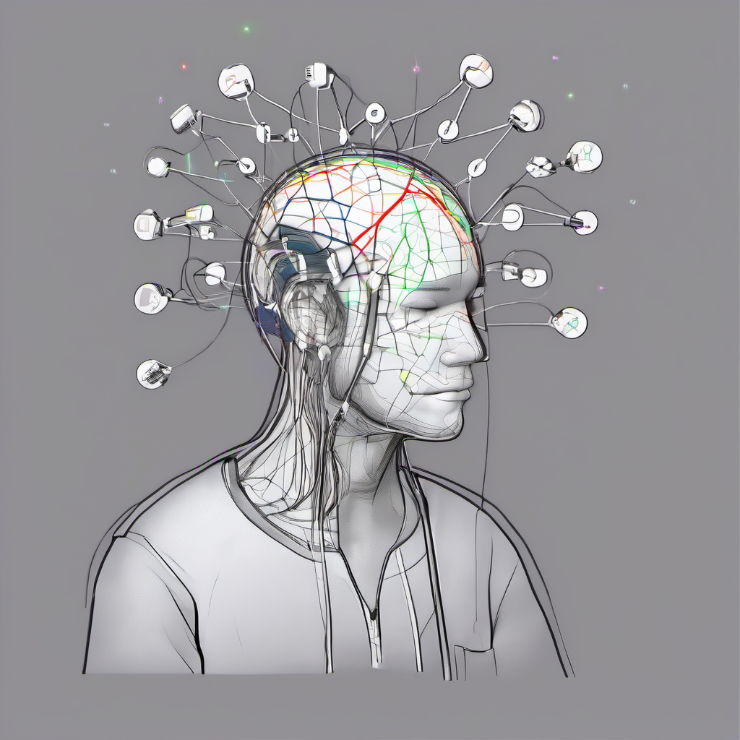

Depression Detection using
EEG Signals
Mentor : Dr. Annushree Bablani
BTP Code : B24AB02
Team Details :
Kampara Venkata Chaitanya - S20210010104
Jayam Phani Naga Preetham - S20210010096
Cheruku Manjith Kumar Reddy - S20210010054

Slide 2

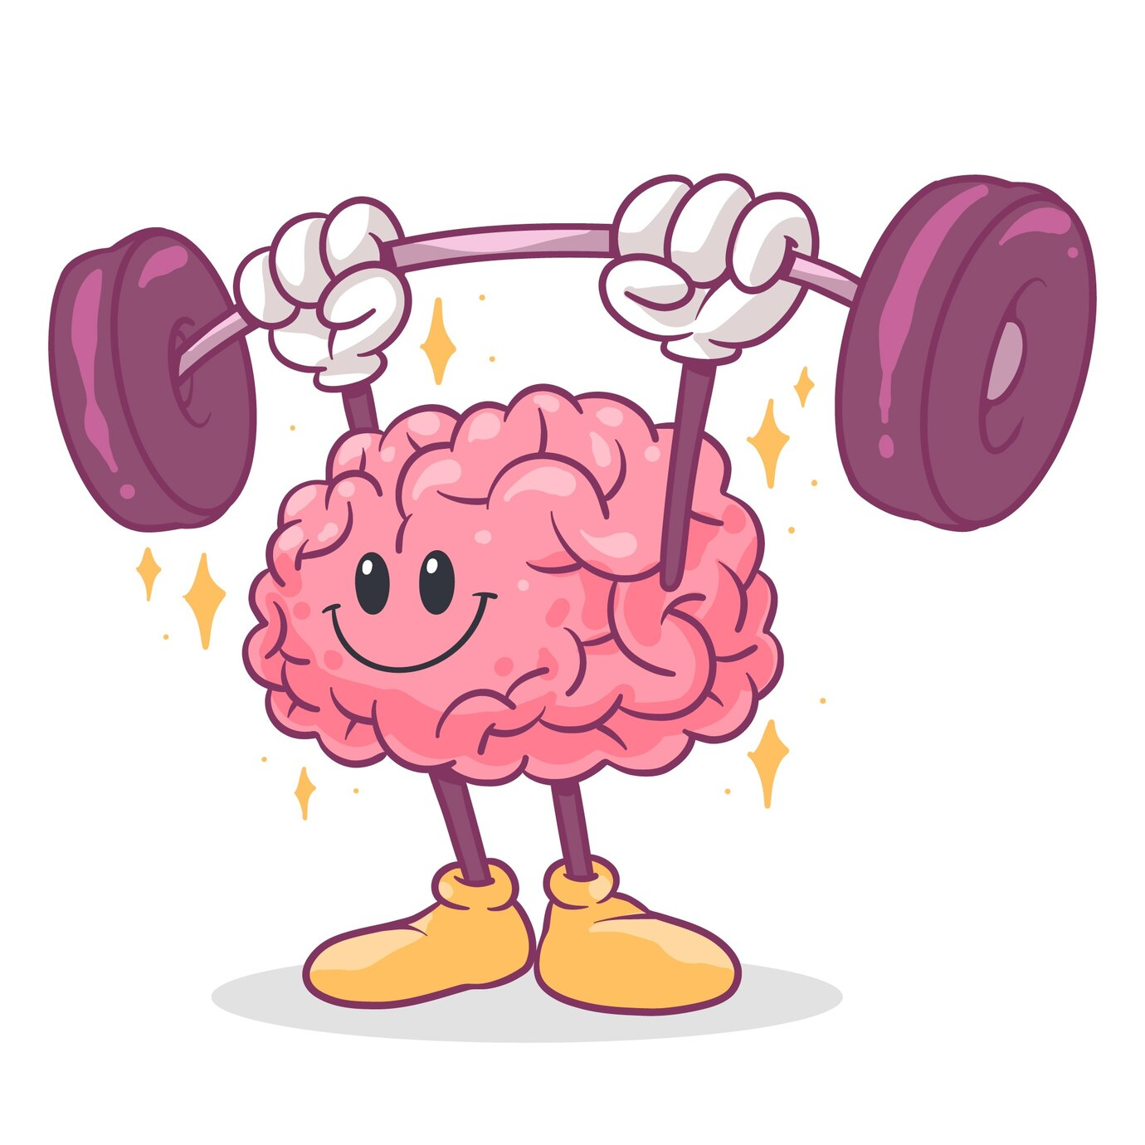
Table of Contents
1
Methodology
2
Implementation of Paper 1
3
Spiking Neural Networks
4
Implementation of Paper 2
5
Timeline
6
References

Slide 3
METHODOLOGY

Slide 4
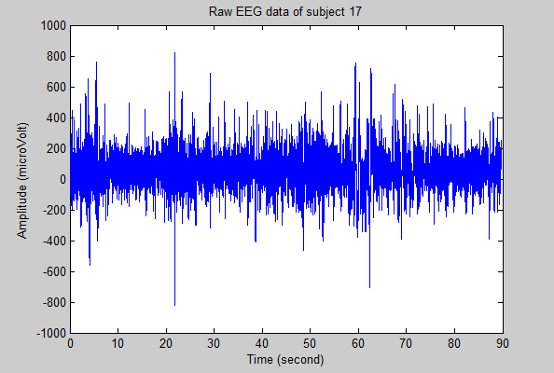
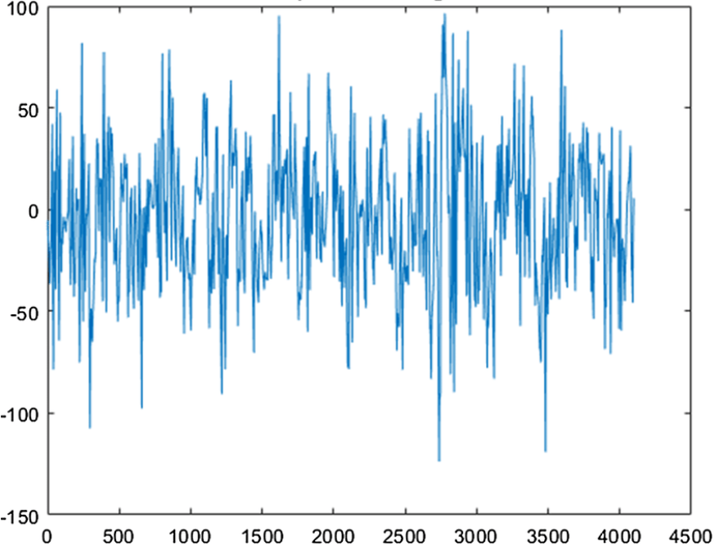
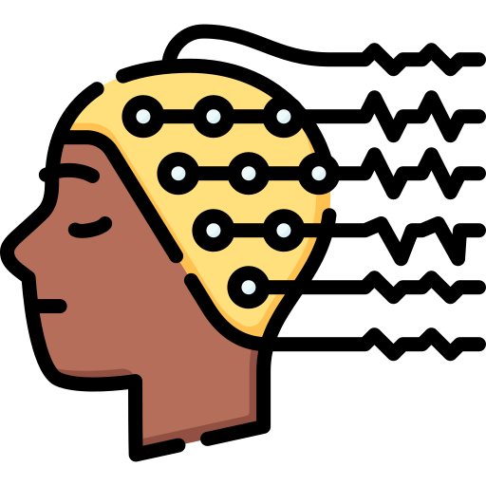
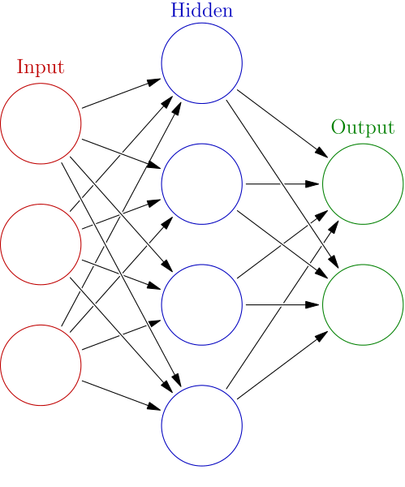



Raw EEG Signal
Preprocessed EEG Signal
Feature
Extraction
Filtering
Data Collection
OR
Healthy
Depressed
Classification Algorithms

Slide 5

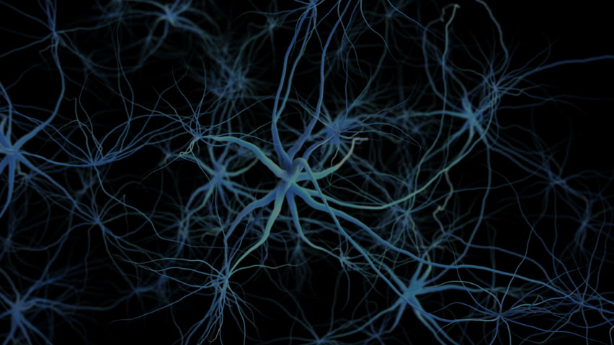
Major depressive disorder diagnosis based on effective connectivity in EEG signals: a convolutional neural network and long short-term memory approach [1]
-et.al.Abdolkarim Saeedi

Slide 6

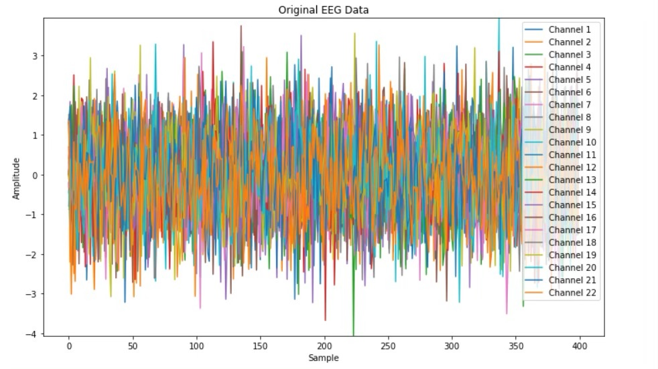
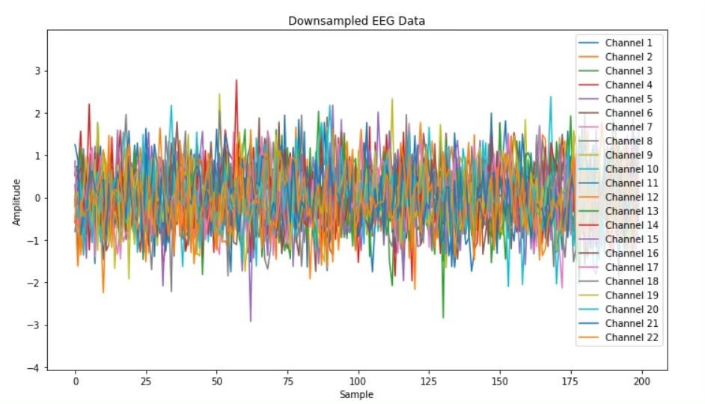
Down Sampling
Downsampling makes it easier for computers to handle EEG data by reducing the amount of information without losing important details.
Downsampling can help clean up noisy signals by smoothing out small fluctuations.

Slide 7
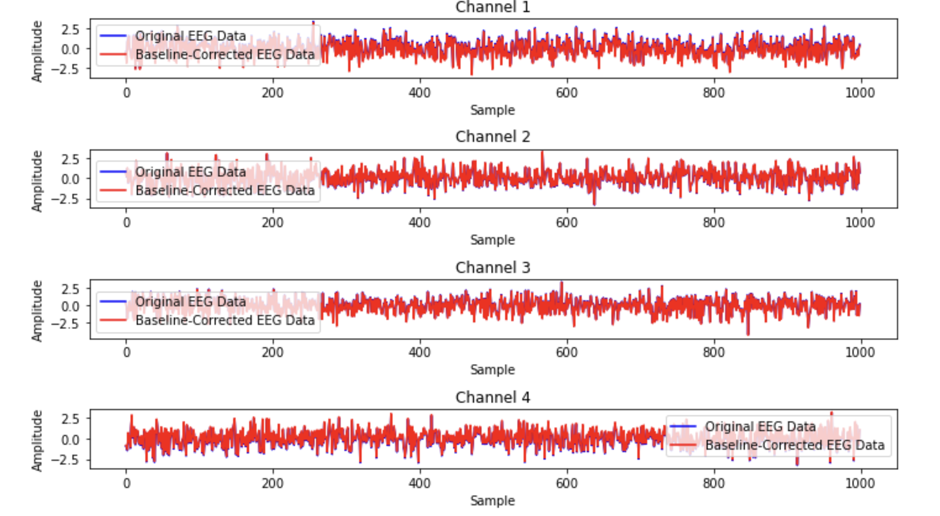
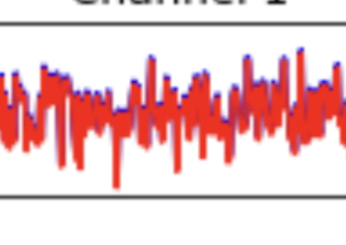
Base line Removal
Baseline removal is a process that resets all spectra to a common baseline

Slide 8
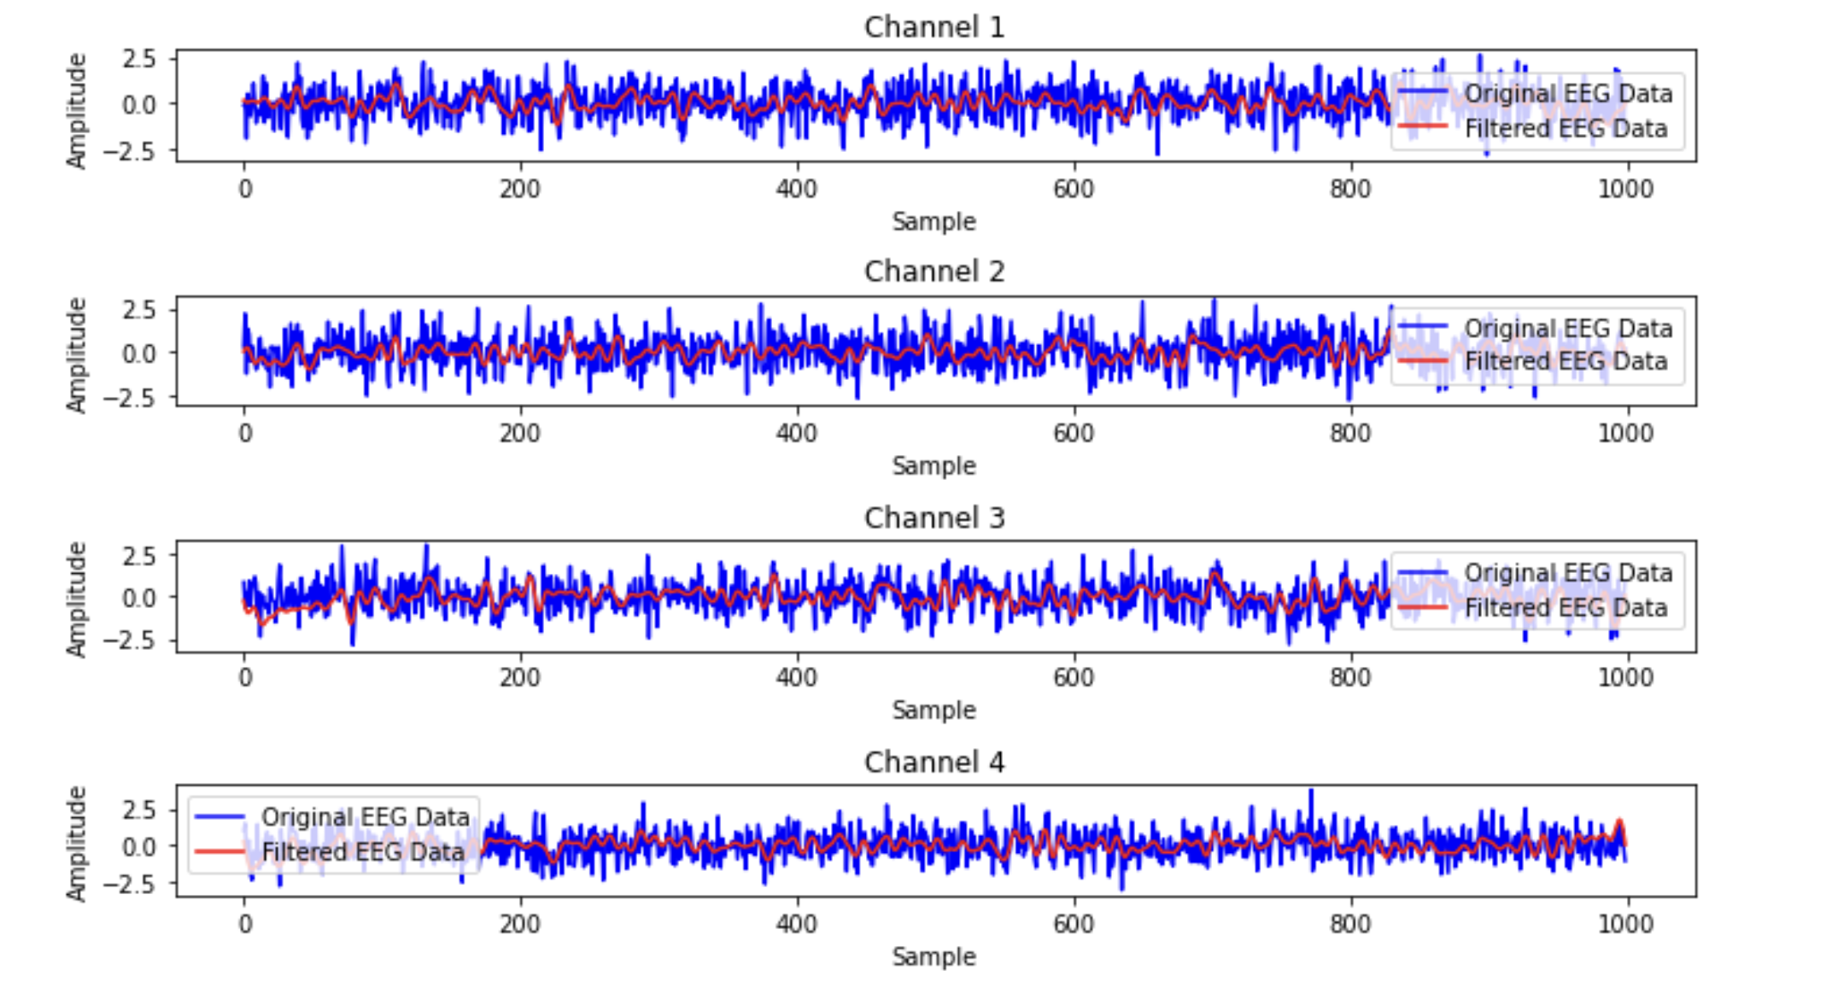
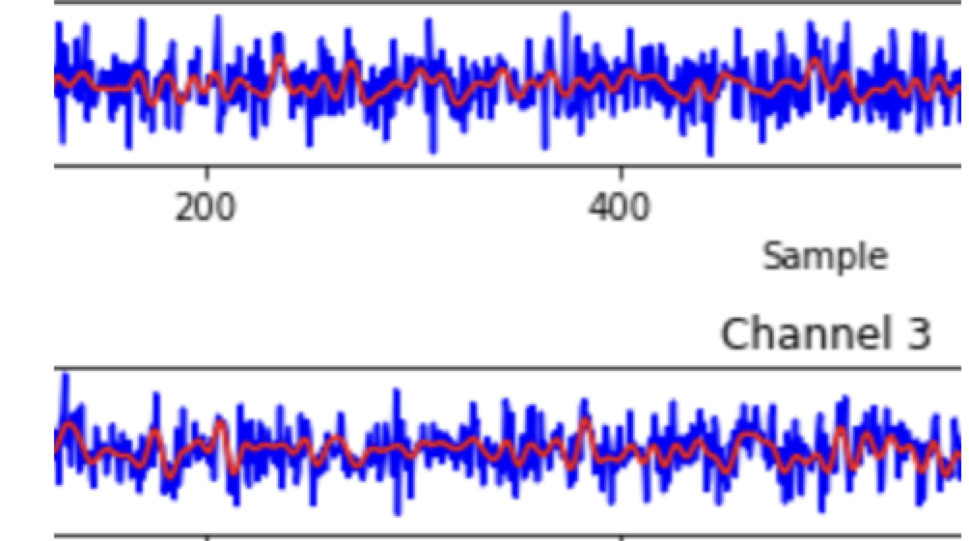
Band Pass Filtering
Allows frequencies within a certain range, while rejecting frequencies outside that range .

Slide 9
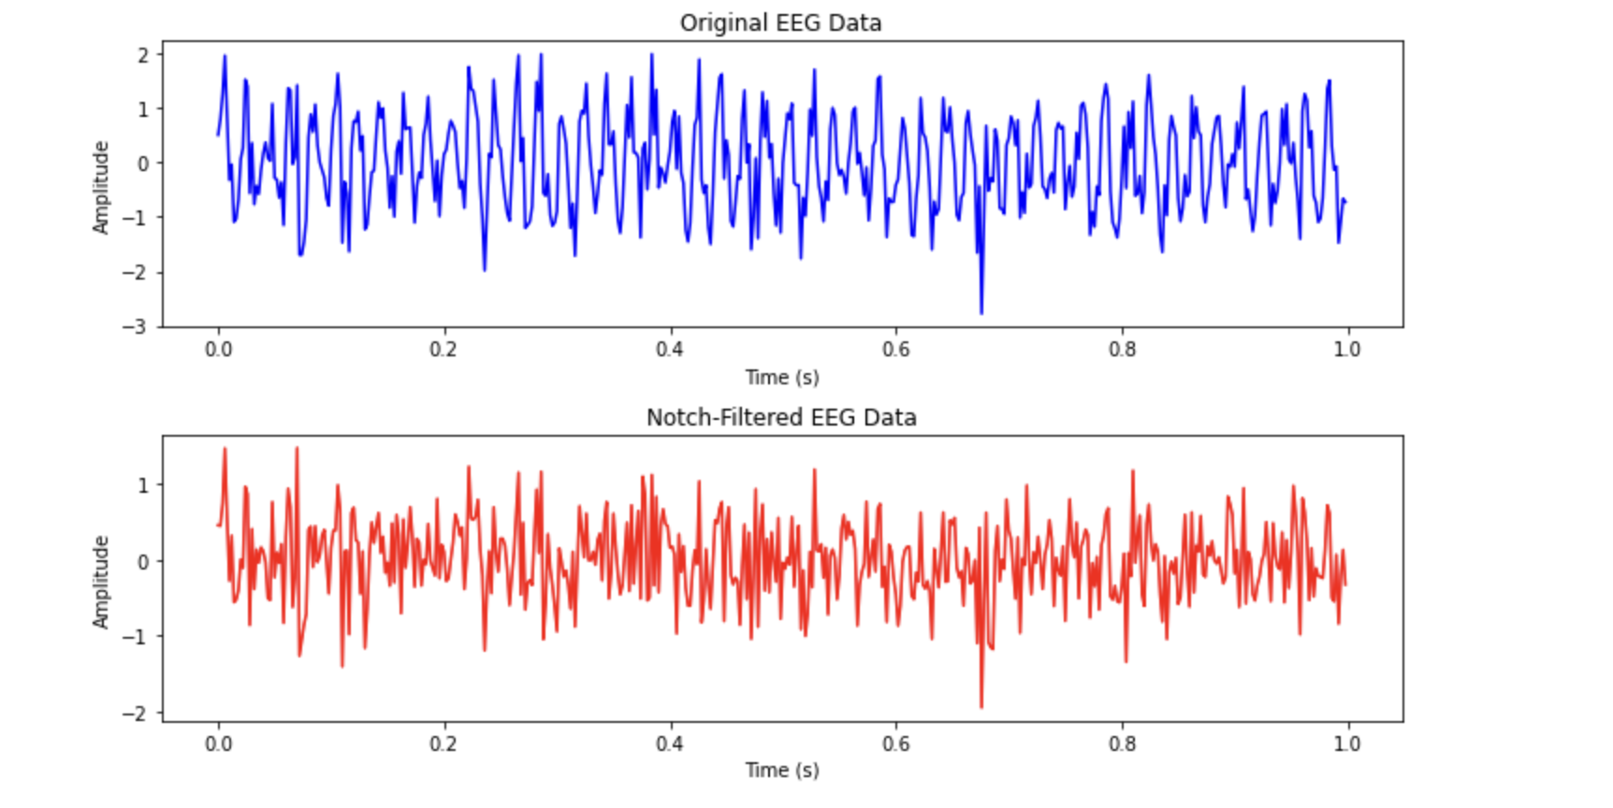
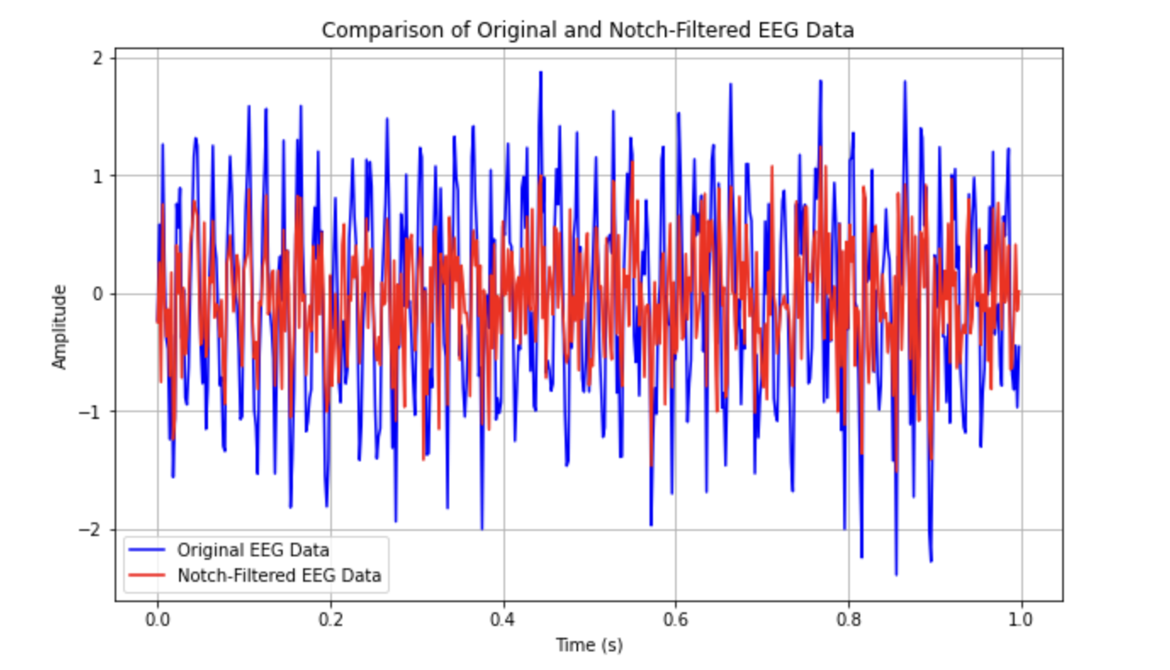

Notch Filtering

Slide 10
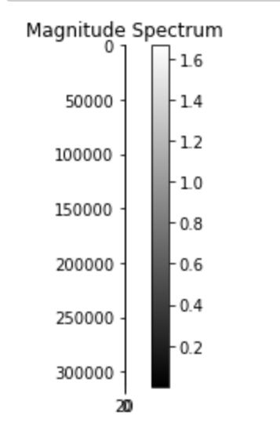
Fourier Transform (FT)
FT is a mathematical tool that decomposes a function of time into its constituent frequencies.
It represents a signal in terms of its frequency components , revealing the frequency spectrum of the signal
The FT is used to analyze EEG signals because it reveals the frequency content of these electrical signals, providing insight into brain activity patterns.
Brighter regions in the visualization indicate higher intensity or strength of a particular frequency band within the EEG signal.

Slide 11
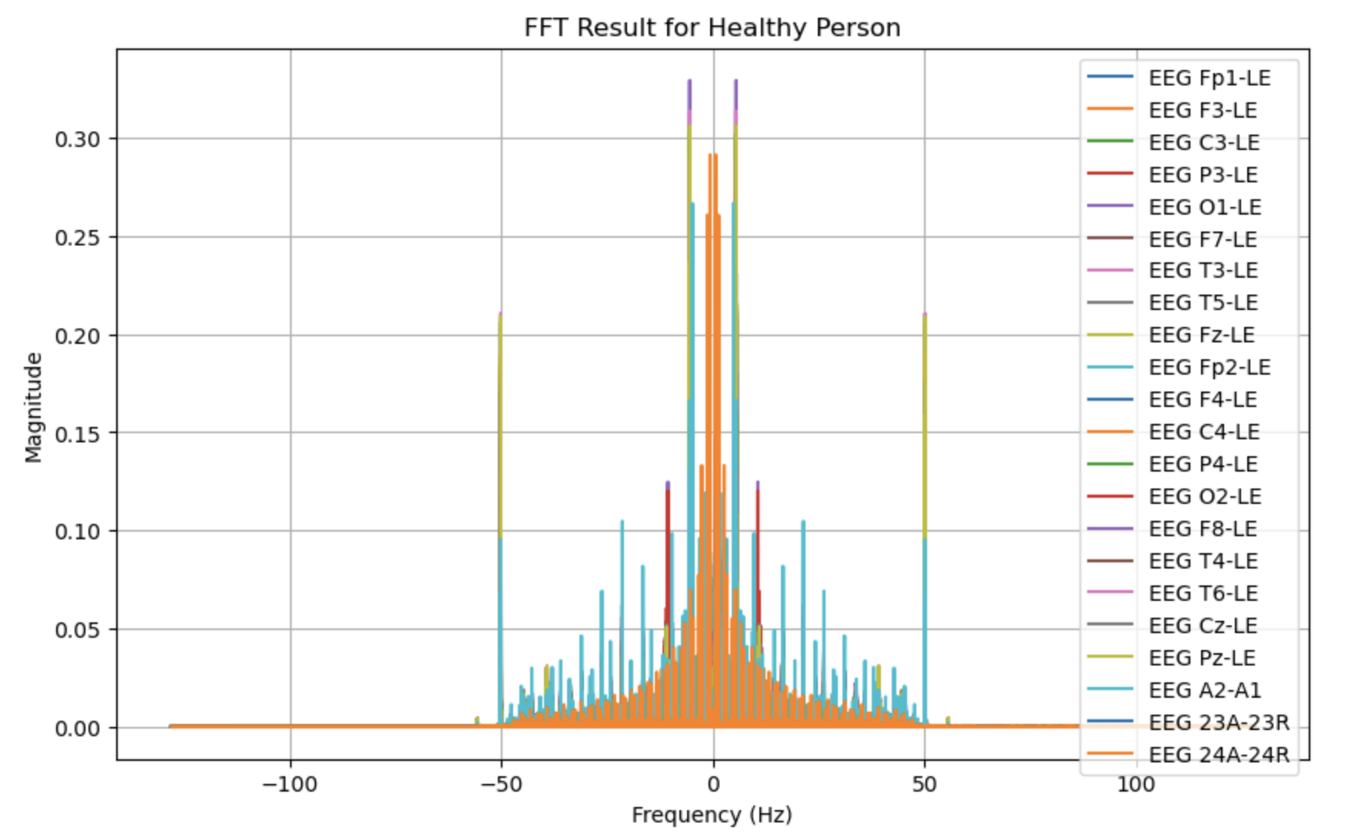
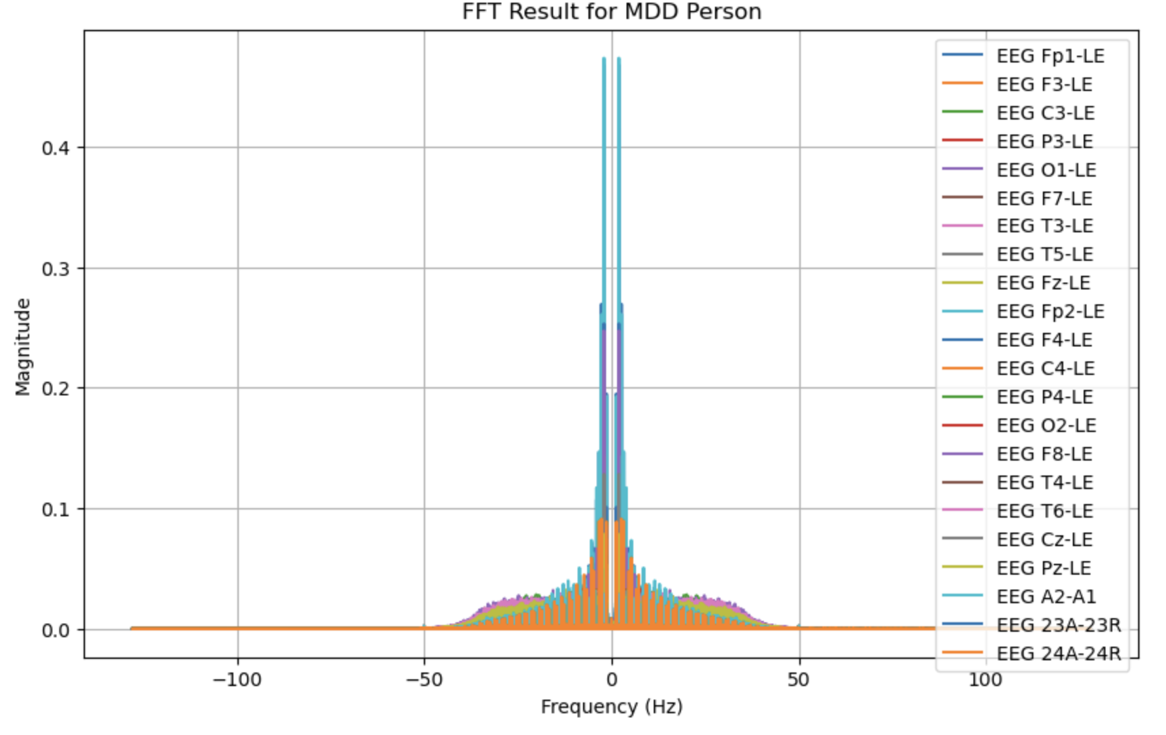
Fourier Transform (Contd)
FFT For Healthy Person
FFT For MDD Person

Slide 12
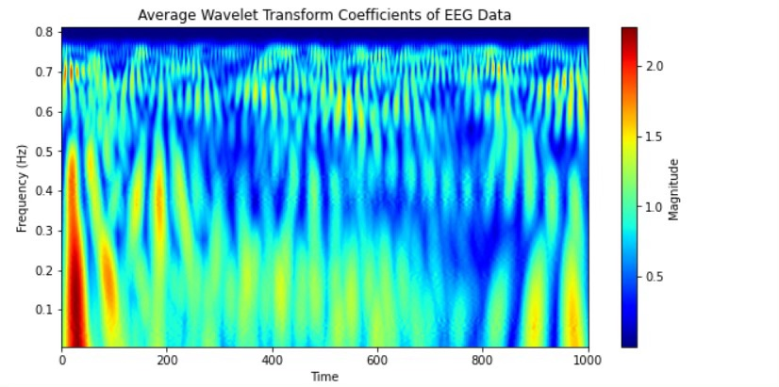
Wavelet Transform
1. Wavelet transform is a mathematical tool used for analysing and processing signals and images at different scales.
2. Unlike traditional Fourier transform, wavelet transform offers both frequency and time localisation, making it suitable for non-stationary signals.
3. It decomposes signals into wavelets, which are small waves of varying frequencies, capturing both high and low-frequency components efficiently.
4. Wavelet transform is widely employed in fields like image compression, denoising, feature extraction, and pattern recognition due to its versatility and effectiveness.

Slide 13
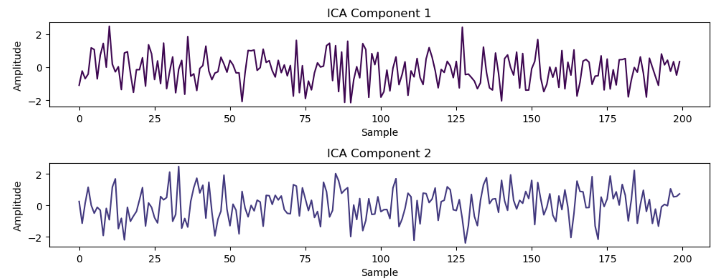
Independent Component Analysis
ICA untangles the mix of brain signals recorded by EEG, revealing individual sources of activity, similar to separating ingredients in a recipe.

Slide 14
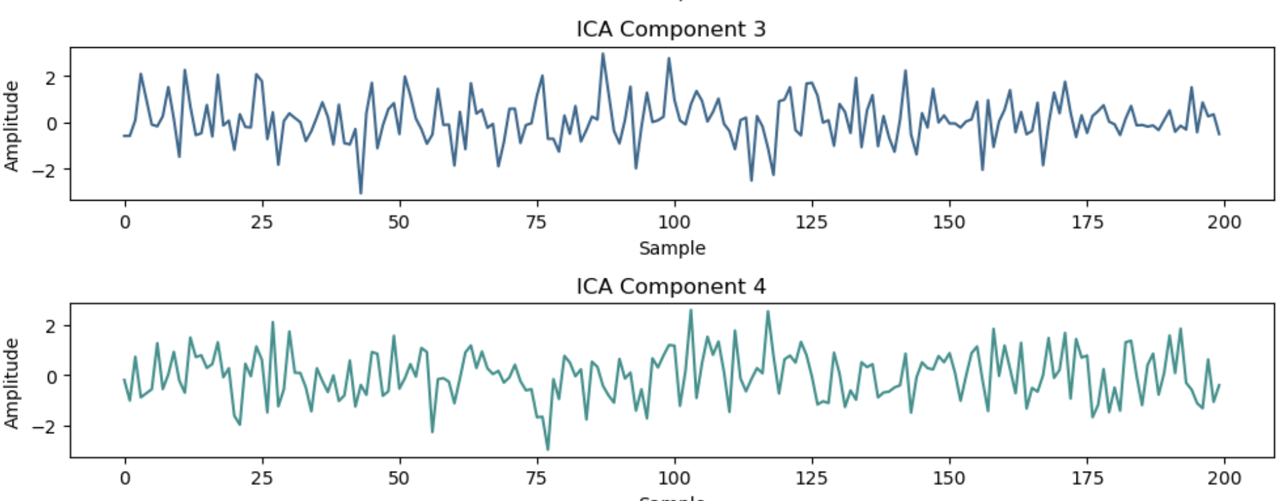
ICA (CONTD)

Slide 15

Result Comparison
Model | Our Results | Paper Results
1D CNN | 92.579 | 95.283% ± 2.109
1D CNN LSTM | 92.810 | 99.245% ± 1.152
LSTM | 91.11 | 89.057% ± 1.849

Slide 16
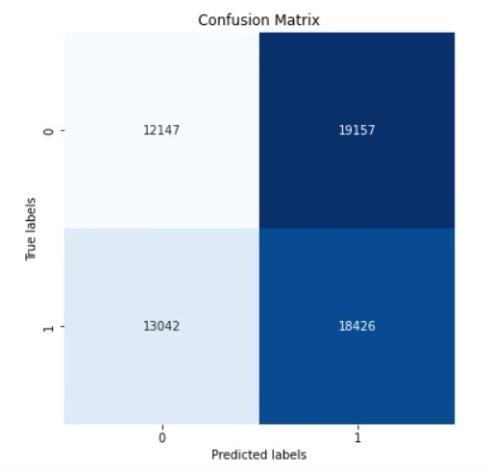
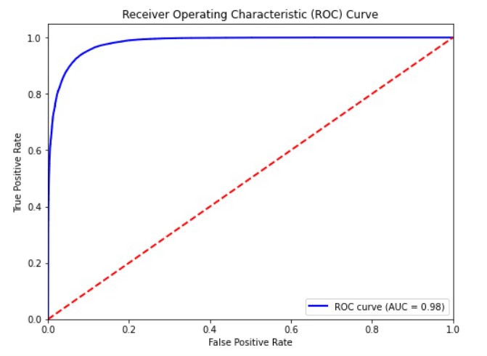
1D CNN
ROC=0.98

Slide 17
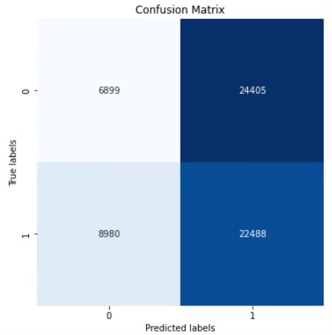
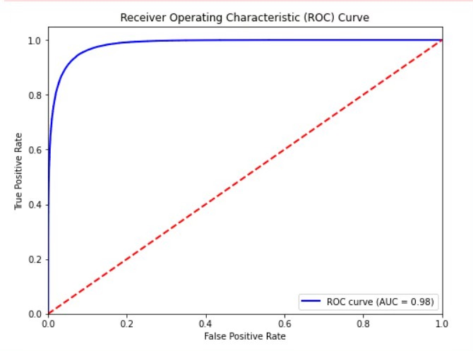
1D CNN LSTM
ROC=0.98

Slide 18
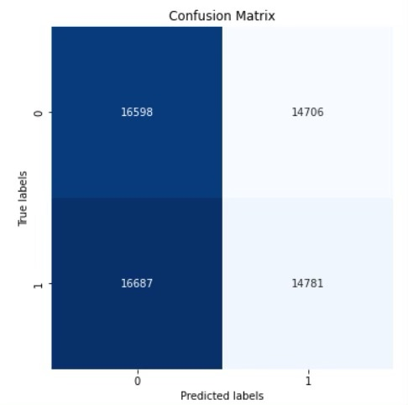
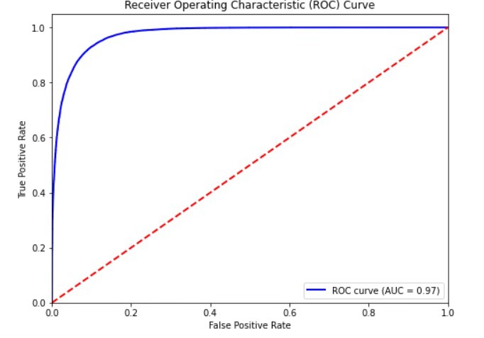
LSTM
ROC=0.97

Slide 19

Depression Identification Using EEG Signals
via a Hybrid of LSTM and Spiking Neural Networks [2]
-et.al.A sam

Slide 20
Spiking Neural Networks
Spiking Neural Networks (SNNs) are a class of Artificial Neural Networks .
In SNNs, information is processed in the form of spikes, which are discrete events representing the firing of neurons.
Neurons integrate incoming signals over time and emit a spike when their membrane potential reaches a certain threshold.
Address Event Representation (AER) is used to transform EEG data into spike trains, simplifying the TBR technique.
SNNs initialize reservoirs with random weights and set a proportion of connections to zero to achieve sparsity.
Leaky-integrate and fire model (LIF), a representation of a spiking neuron, can be employed to emulate each neuron within the SNN model. Notably, temporal dynamics are integrated into the operations, alongside the synaptic states of the neurons.

Slide 21
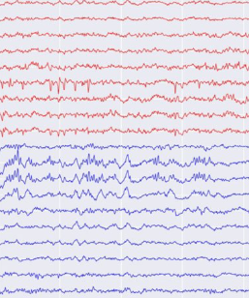
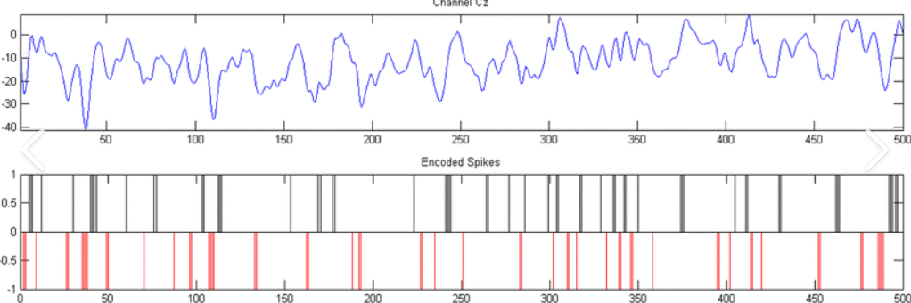
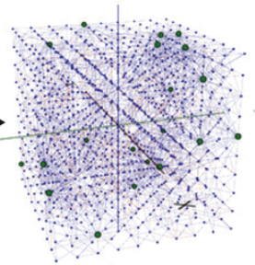
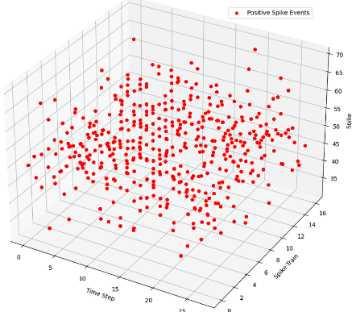
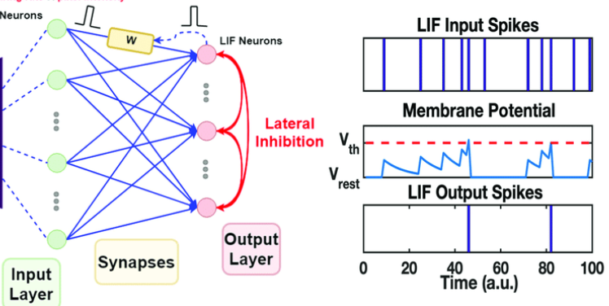
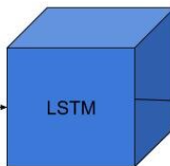
SNN WorkFlow
Spike Encoding
SNN Intialization
EEG Data
OR
Healthy
Depressed
LIF Spikes
https://www.frontiersin.org/journals/neuroscience/articles/10.3389/fnins.2019.00812/full

Slide 22
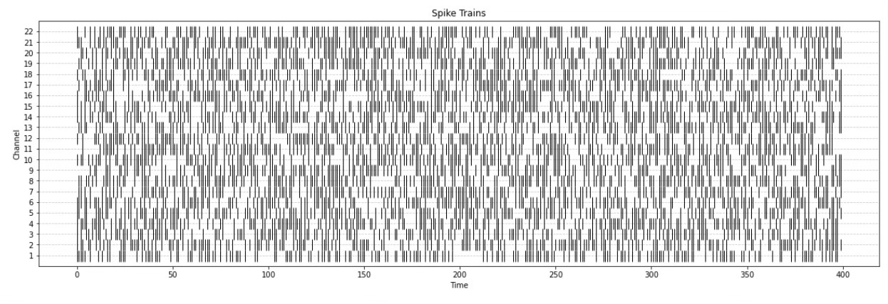
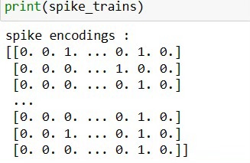
Spike Encoding
Spike Encoding (binary)
The continuous EEG data is converted into spike trains using an Address Event Representation (AER) approach, which is a simplified version of the Threshold-Based Representation (TBR) technique.

Slide 23
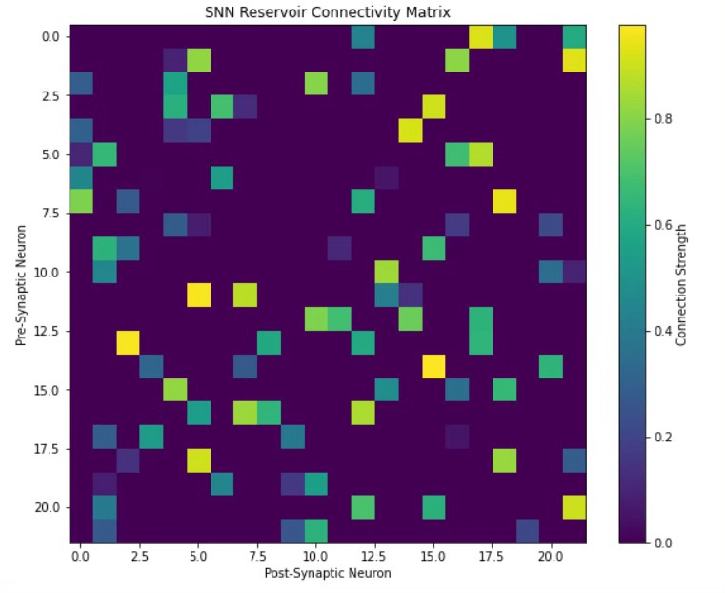
Spike Initialization
Sparse initialization : utilizes a "small-world" connectivity rule to initialize the connections between the neurons.
This involves introducing a parameter called the "small-world radius" (SWR) that defines the range within which neurons are potentially connected.
By using sparse ratio , higher proportion of weights will be considered as active connections, while lower weights will be assigned to zero.

Slide 24
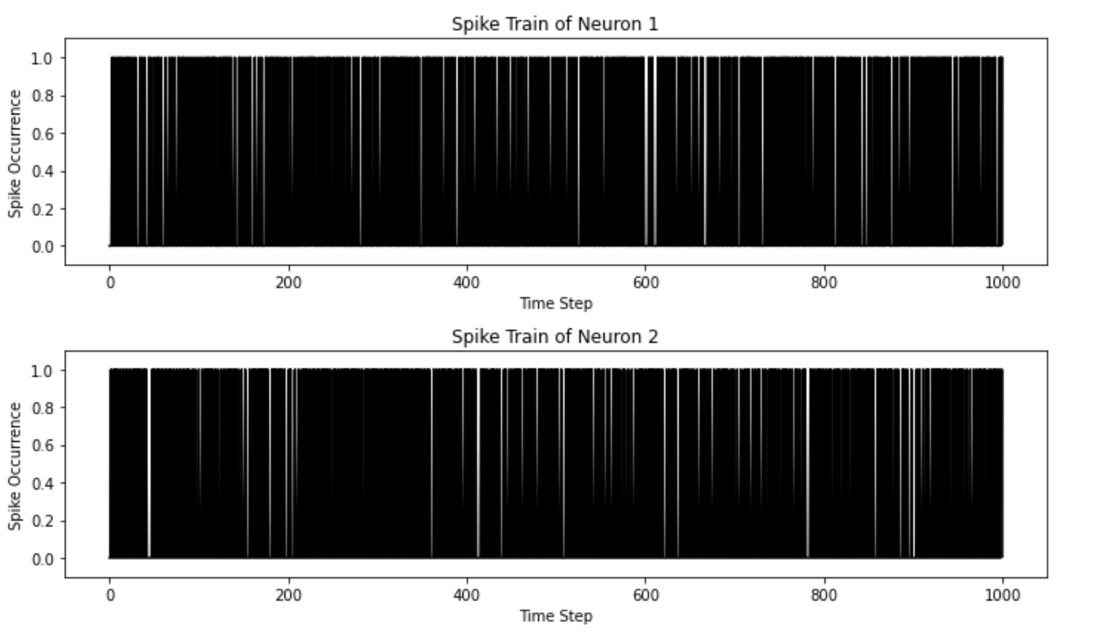
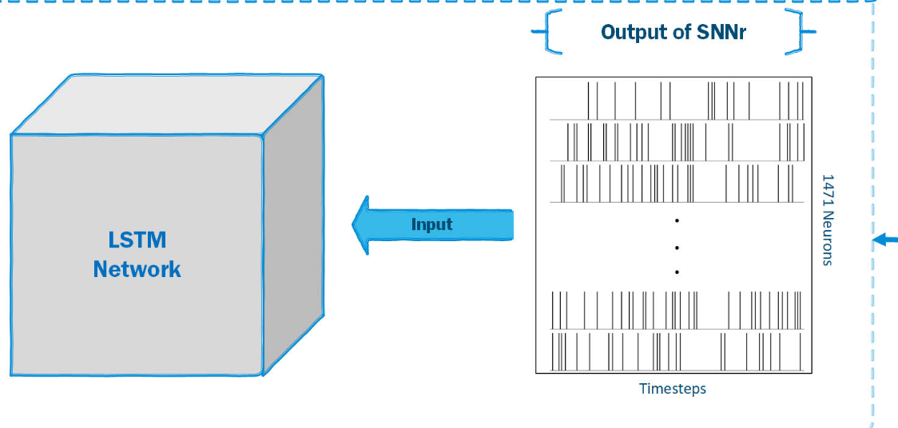
LIF
Whenever the rate of change in the EEG signal exceeds the variable threshold for a channel, a positive spike is generated.
Negative spikes are generated when the rate of change goes below the threshold.
These spike trains are then fed into the input neurons of the SNN reservoir.
The LIF neuron model integrates the incoming spikes and generates output spikes based on the dynamics of the network.

Slide 25
Timeline
01
02
03
04
Review 01
Review 02
Review 03
Review 04
Done Literature review by reading various research papers.
Understanding Dataset
Implementation
Preprocessing
Feature Extraction
Classification Algorithms
Collecting and working on Real Time EEG Data
Diving into deep other models to get better accuracy
Creating Structured documentation.
Creating UI
Further Improvements

Slide 26
References
[1] Mumtaz, W., Xia, L., Ali, S. S. A., Yasin, M. a. M., Hussain, M., & Malik, A. S. (2017). “Electroencephalogram (EEG)-based computer-aided technique to diagnose major depressive disorder (MDD)”. Biomedical Signal Processing and Control, 31, 108–115. https://doi.org/10.1016/j.bspc.2016.07.006
[2]A. Sam, R. Boostani, S. Hashempour, M. Taghavi and S. Sanei, "Depression Identification Using EEG Signals via a Hybrid of LSTM and Spiking Neural Networks," in IEEE Transactions on Neural Systems and Rehabilitation Engineering, vol. 31, pp. 4725-4737, 2023, doi: 10.1109/TNSRE.2023.3336467.

